Slide 1

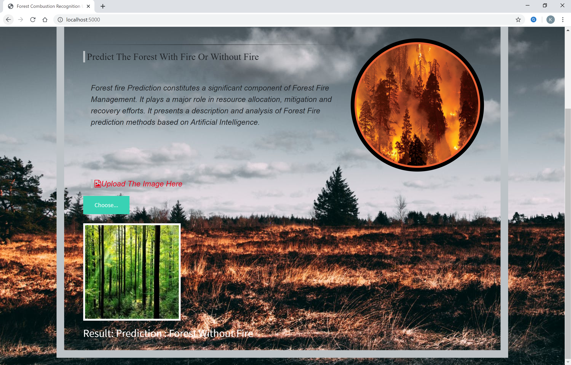
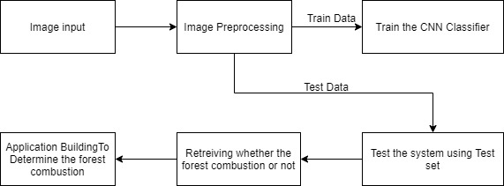
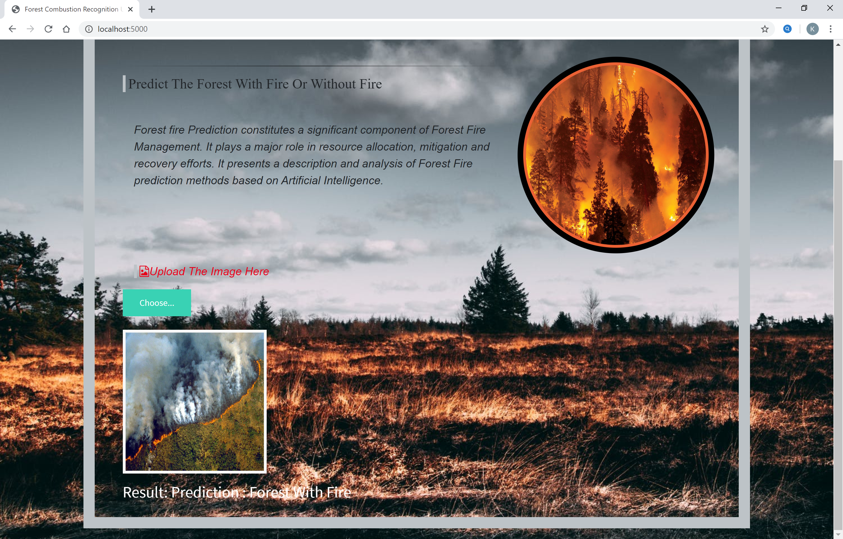
Fire Recognition in forests using Deep Learning
G. Sai Sheshank-17MIS7099 | Dr. Prabha Selvaraj | VIT-AP UNIVERSITY
MOTIVATION
Our project's major goal is to reduce forest fires and increase forest protection while also creating a user-friendly environment that everyone may use.
They should also be able to use the software from any location and at any time.
Forest Combustion Recognition's goal is to protect the environment (plants and trees), wildlife, and tribal people who live near the forest.
Prevention of forest fires is one of today's most important tasks as well as appropriate preparedness for effective fighting against them. To do so, it is vital to have detailed knowledge on AI, deep learning techniques (CNN) to visualize/recognize through the images we provide the model to forecast, we can determine if the woodlands are burning or not.
OBJECTIVE
Forest Combustion Recognition's goal is to protect the environment (plants and trees), wildlife, and tribal people who live near the forest. It can function regardless of the weather and can be utilized wherever and whenever we wish. This project is completed with the use of artificial intelligence (AI) and deep learning techniques.
Major Prerequisites
Datasets containing all types of images and different view of the images.
H/W & S/W:
A laptop / computer, 8-GB RAM , 32-GB ROM, 64 Bit
Front End: HTML
Back End: Python – We use following GUI’s Anaconda Navigator -> Jupyter Notebook, Spyder it is a desktop GUI, Anaconda Prompt
Project Flow
CONCLUSION
We used AI, deep learning techniques (CNN), and Python 3 to create this project. Using image processing techniques, this study provides an effective forest fire detection approach. Train and test models are used in the method. It will train our model and then test whether or not there is a fire. To detect the fire, five fire detection criteria are used. The proposed algorithm's performance is evaluated using a data set consisting of diverse forest photographs gathered from the Internet, 100 of which were actual fire pictures while the other 100 were not. The findings reveal that the proposed method has a high detection rate. These results indicate that the proposed method is accurate and can be used in automatic forest fire-alarm systems.
RESULTS
REFERENCES
Anon, 1995. Report of the Committee of Enquiry into Forest Fires in Himachal Pradesh and Uttar Pradesh in 1995, Government of India.
Bahuguna, V.K. and Upadhyay, A., 2002. Forest fires in India: Policy initiatives for community participation; International Forestry Review, 4(2).
FAO, 2003.Wildland Fire Management Terminology. FAO Forestry Paper 70. FAO, Rome.
https://www.researchgate.net/publication/261272818_Artificial_intelligence_for_forest_fire_prediction
https://ieeexplore.ieee.org/document/5695809/metrics#metrics
Contact Details
Saisheshank Gaddam
9133499615
saisheshank.gaddam@vitap.ac.in

